Slide 1

Noon
Case Study
Syed Askari Raza

Slide 2
Analysis Overview
Analysis Approach & Tools
The objective through this survey was to understand the following: Conversion Funnel of new users and registered users who log in to the app Funnel Health Recommendations and Action Plan to improve funnel health Strategy to drive retention Segmentation of Users into cohorts Improvements within the User App to improve journey
Querying of data tables using SQL to perform data cleaning SQL Aggregation functions usage to find counts of users and at different app touch points Visualization is performed on Python using Plotly and Pandas Integration of SQL within Python to incorporate Visualization and Querying together Recommendations and Strategy based on findings

Slide 3
ONBOARDING FUNNELS

Slide 4
Users Onboarding
Registered Users Onboarding
Guests Onboarding
The users accessing the Noon App are segmented into two categories: Guest Onboarding funnel Registered Users funnel The entire user journey defined for both categories is as follows:
First APP Entered
Phone Entered
Entered Dashboard
OTP verified
Grade Screen Launch
User signed up
Country Screen launch
Name screen launch
Gender screen launch
Grade screen launch

Slide 5
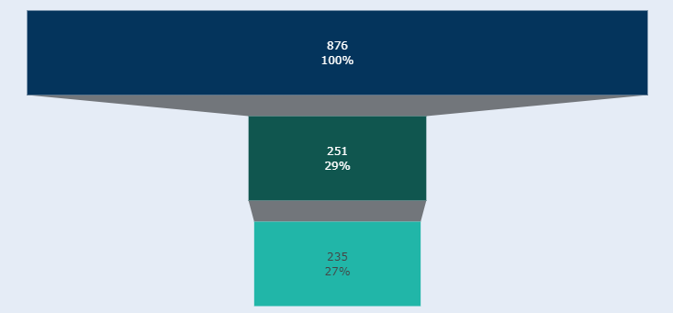
Onboarding - Guests
Key Findings
January 2022
71%
Drop at grade screen launch
Entered Dashboard
Grade screen launch
Country screen launch
2%
Drop at Country screen launch
Key Takeaways:
Funnel health for guests in January 2022 is poor from level 1 to level 2 since a 71% drop in users
Users who reach the grad screen also tend to mostly fill out the country details on country screen

Slide 6
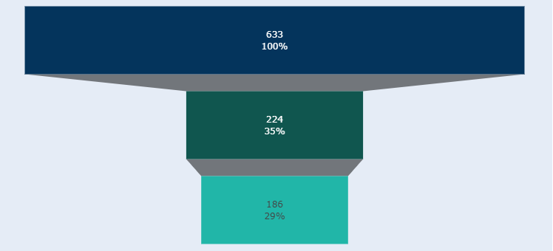
Onboarding - Guests
Key Findings
February 2022
65%
Drop at grade screen launch
Entered Dashboard
Grade screen launch
Country screen launch
6%
Drop at Country screen launch
Key Takeaways:
Funnel health for guests in February improved as compared to January 2022
65% users drop off from the dashboard screen

Slide 7
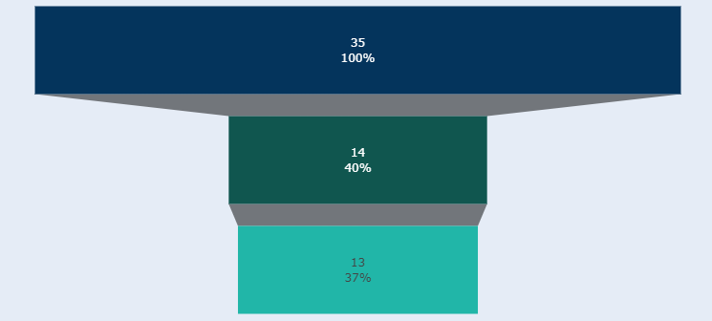
Onboarding - Guests
Key Findings
March 2022
60%
Drop at grade screen launch
Entered Dashboard
Grade screen launch
Country screen launch
3%
Drop at Country screen launch
Key Takeaways:
Funnel health for guests in March 2022 has improved from level 1 to level 2 with a 60% drop in users
Improved retention from grade screen launch to country screen launch

Slide 8
Onboarding - Guests
Key Findings
Funnel Health deteriorates the most at the grade screen launch with an average drop rate of 32% over three months
The retention rate on country screen launch is healthy at an average of 4% drop rate from grade screen to country screen

Slide 9
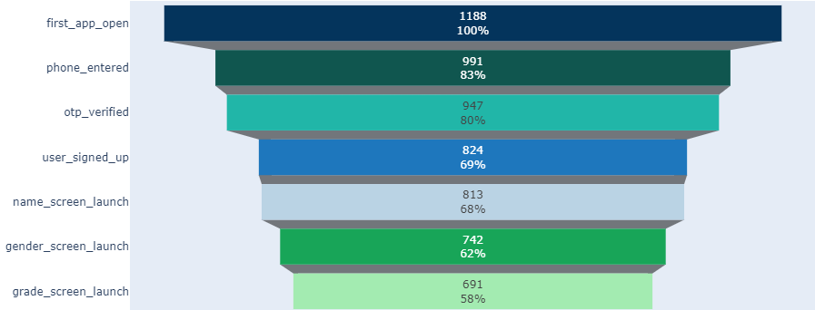
Onboarding - Registered Users
Key Findings
January 2022
17%
Drop at phone enter screen
11%
Drop at user signed up screen
Key Takeaways:
Funnel Health is considerably stable with less drastic drops at different stages
Most users drop out when entering their phone number and OTP

Slide 10
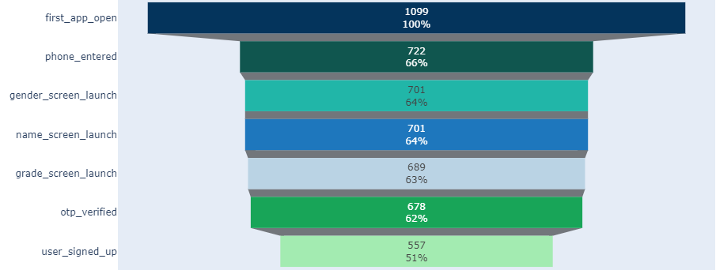
Onboarding - Registered Users
Key Findings
February 2022
34%
Drop at phone enter screen
11%
Drop at user signed up screen
Key Takeaways:
Poor funnel health in February 2022 since a drastic drop in users who go on to enter their phone number

Slide 11
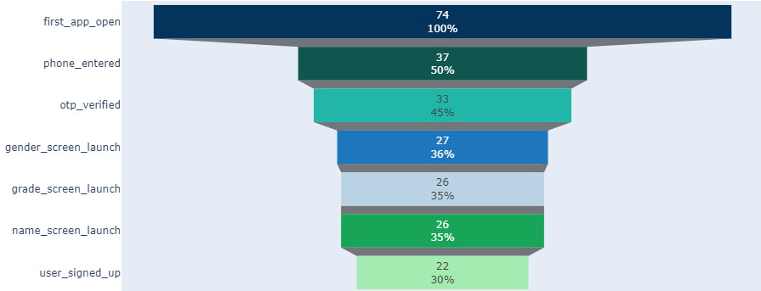
Onboarding - Registered Users
Key Findings
March 2022
50%
Drop at phone enter screen
70%
Drop at user signed up screen
Key Takeaways:
Funnel health has deteriorated from January to March since less retention of users
Only 50% of users who access the app actually go on to enter their phone number

Slide 12
Onboarding - Registered Users
Key Findings
Conclusion
Funnel Health deteriorates the most when users have to enter their contact numbers
The grade, name, and gender screens have an average drop rate of only 6% which is considerably good retention
The User Journey should be made simpler by further simplifying the retrieval of phone number or by using an alternative sign up method

Slide 13
Onboarding
Recommendations
First APP Entered
Country Screen
Based on findings, the user flow should be as such:
Grade Screen
Phone Number Screen
OTP (Auto Populate)
Signup Complete
Name & Gender Screen

Slide 14
ENGAGEMENT

Slide 15
Engagement Analysis
The dataset provides data for January 2022 and February 2022
The activity types in engagement modules have been segmented into 9 different modules

Slide 16
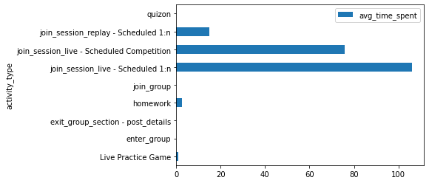
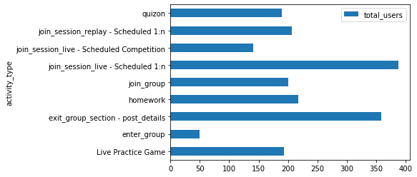
Engagement
Key Findings
January 2022
388
Users watched scheduled live sessions
106 mins
Average watch time of scheduled live sessions
Key Takeaways:
Most users engage in scheduled live sessions and homework
Average watch time is higher for sessions (both replay and live) and for competitions

Slide 17
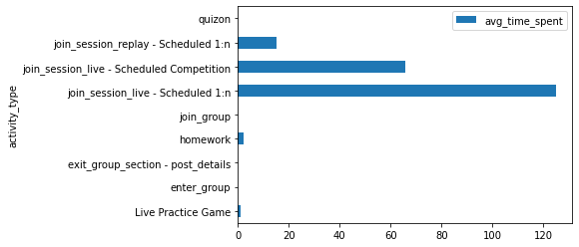
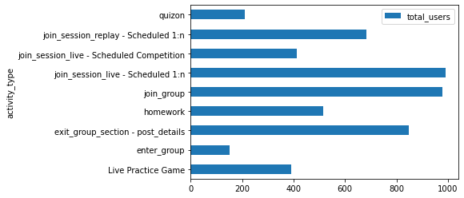
Engagement
Key Findings
February 2022
391
Users engaged with live practice game
124 mins
Average watch time of scheduled live sessions
Key Takeaways:
The viewership and engagement with practice live game has increased from 193 users to 391 users within a month

Slide 18
Engagement
Key Findings
Conclusion
The best source of engagement to retain users for a higher time on the App is primarily the scheduled live sessions
The Live practice game has attracted users as the engagement has increased by approximately 100% month on month
Strategy to introduce modules like live practice games and quizzes can help build higher engagement and stay time on the App

Slide 19
Steps to Drive Retention
Objective | Action Topic | Details | Next Step | Owner
Watch time | User stay time | Increase the average time users spend on the App | Users spend the most time on scheduled lectures/sessions. A recommendation system shall be introduced that recommends the most relevant recorded sessions to the recently watched session | Data Science, Course Designer
Retention | Incentivization | Incentivize users to stay on the app longer by offering chances to gain points | Introduce voucher codes for ebooks, retail book stores, or redeemable coupons as an incentive for the students to study for quizzes and tests/homework | Marketing, Customer Acquistion
 | Content Quality | Presenters need to be trained more on engagement | Pushing more towards: 1.Two way communication 2. Gamification Streams 3. Thorough concept demonstrations 4. Ask questions and answer queries of students | Professors, Instructors
 | Content types & Categories | Pushing user interest categories and content types | Categories: Past Papers, FAQs, Tips Content Types: Content [more concept immersive shows], gamification shows | Instructor Acquisition

Slide 20
Segmentation of User Base
Action Topic | Details
Gender | To gauge demographic data
Age | Age brackets that are logging into the App
Credentials based | Students/Users need to be divided among groups that lie within different range of percentages/grades - The content and its depth will vary according to the student’s credentials in past grades
Aspiration segmentation | Content segmentation based on what the student wants to pursue in the future. High school students aim to pursue a course and noon’s coursework should be aligned with that
Primary aim/target to come on the app | Practice/Concept building/Past Papers/Memorization Content should be relevant to these targets of students. Relevant required content is likely to better divide the user based and increase their watch time and retention

Slide 21
Noon’s Proposed User Journey
Module | Details
Country | Self explanatory
Grade/Class | Self explanatory
Aim to learn | Practice/Concept building/Past Papers/Memorization
Contact No. | Self explanatory
OTP | Self explanatory
Signup Complete | Self explanatory
Name, Age, gender | After signup, name, age, gender prompt
Credentials (optional) | Optional prompt to add your last grade details

